Slide 1
Land Cover Classification Using Sentinel-2 Satellite Imagery
Based on EuroSAT dataset from Kaggle

Slide 2
Team Members
Abdulrahman Bassuni
(Team leader)
Mohamed Osama
Menna Mohamed
Abdullah Bassuni
Nour Ahmed
Saif Ismail

Slide 3
Agenda:
Introduction & Team Members
Problem Statement & Challenges
Our Unique Value Proposition
Dataset Overview (EuroSAT)
Methodology & Model Development (ResNet-50)
Final Model Performance (99.13% Accuracy)
Deployment & Live Web Application
Target Users & Real-World Use Cases
Tools & Technologies Used
Project Timeline & Deliverables
Live Demo
Conclusion & Q&A

Slide 4
Challenge:
Accurate and automated land cover classification from satellite imagery remains difficult due to:
High visual similarity between certain classes (e.g., highways vs. permanent crops, industrial vs. residential areas).
Variations in lighting, atmospheric conditions, clouds, and seasonal changes in Sentinel-2 images.
Large-scale, real-world diversity across Europe (27,000 images covering forests, rivers, cities, farms, etc.).
Need for a fully automatic system that works reliably with freely available RGB satellite data (no expensive multispectral or commercial imagery).
Why previous approaches struggled:
Most published models on EuroSAT achieved 98.0–98.9% accuracy.
Many required complex preprocessing, extra bands (NDVI, etc.), or heavier models.
Real-world deployment was still slow and inconsistent.

Slide 5
What this project solved:
Achieved 99.13% test accuracy on the full EuroSAT benchmark using only standard RGB bands from Sentinel-2 and a single fine-tuned ResNet-50 — proving that near-perfect, fully automated land cover classification is now possible with free, globally available satellite imagery.
Unique Value Proposition:
99.13% accuracy – highest reported on full EuroSAT benchmark .
Uses only free Sentinel-2 RGB images (no extra bands, no paid data).
Fully automatic classification in milliseconds .
Lightweight ResNet-50 – runs on CPU, exportable to ONNX/TFLite.
Ready for real-time land monitoring & GIS integration worldwide .

Slide 6
Primary Users:
Government environmental & urban planning agencies Detect illegal constructions and update city land-use maps automatically every 5 days.
Agricultural and disaster management authorities Instantly classify crop types and assess flood/fire damage from new satellite images.
NGOs and climate research organizations Monitor deforestation and produce accurate SDG-15 reports using free global data.
GIS and remote sensing professionals worldwide Plug the model into QGIS/ArcGIS to generate up-to-date land cover layers in one click.
Key Functionalities:
• Instant classification of Sentinel-2 images into 10 land cover types.
• 99.13% accuracy using only free RGB data.
• Works on any new satellite image without retraining • Runs in milliseconds even on regular laptops.
• Outputs ready for QGIS, ArcGIS, or web dashboards.

Slide 7
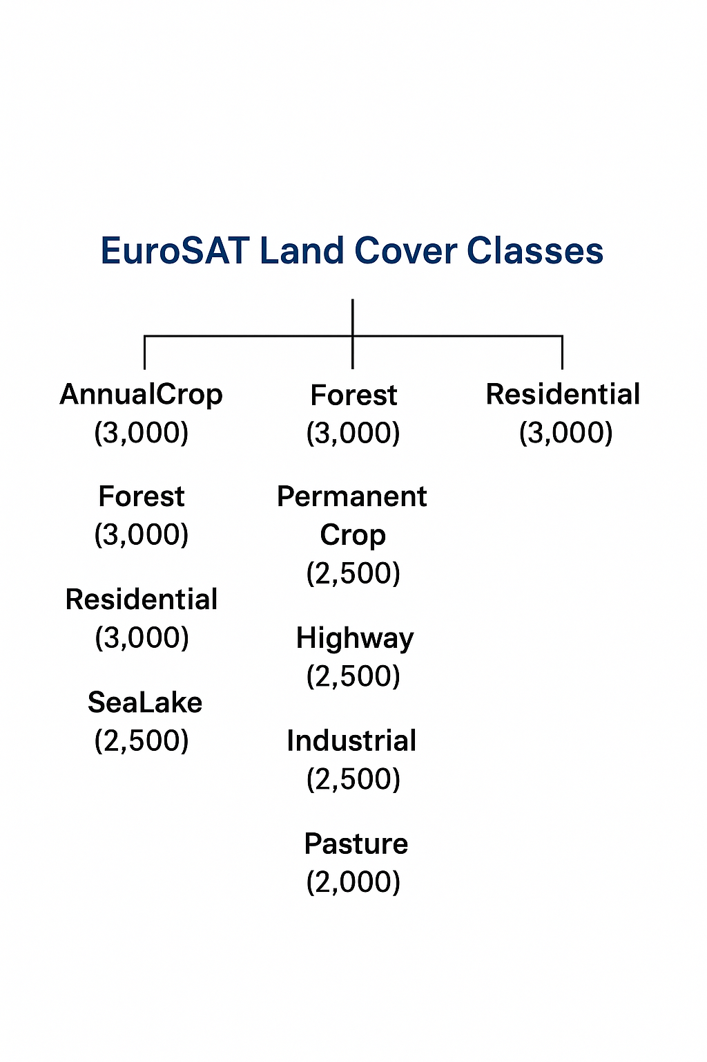
Dataset & Data Structure
Name: EuroSAT (Sentinel-2 RGB).
Images: 27,000 (64×64 pixels).
Classes: 10 land cover types.
Source: Free satellite imagery.
Link: https://www.kaggle.com/datasets/mohamedelnahry/land-type-classification-using-eurosatsentinel-2
Dataset:

Slide 8
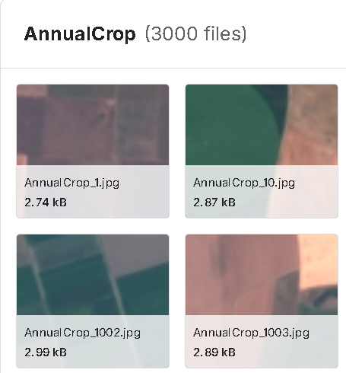
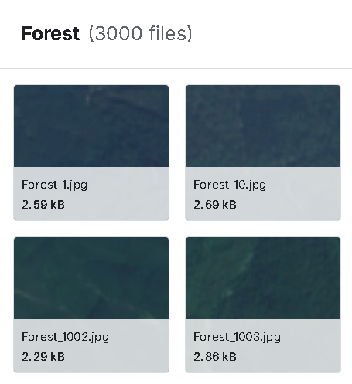
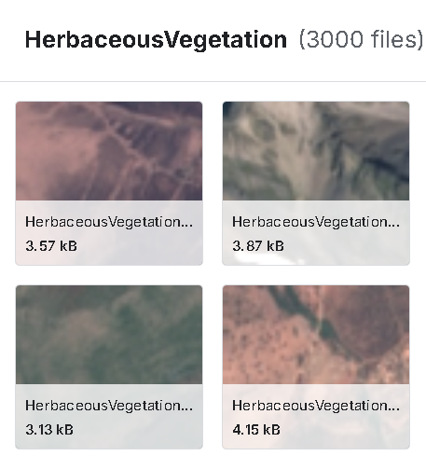
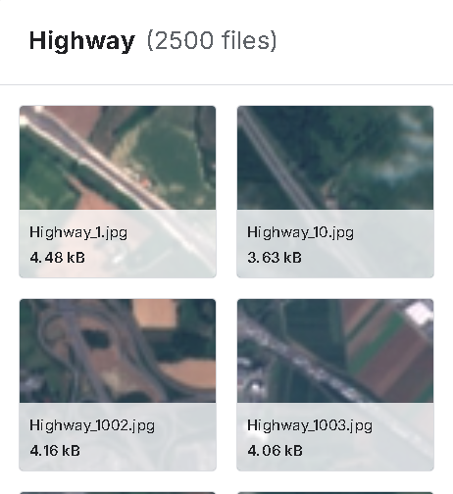
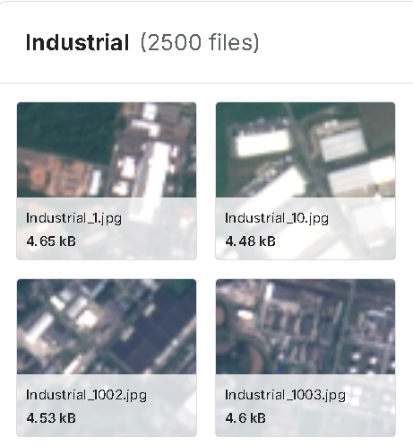
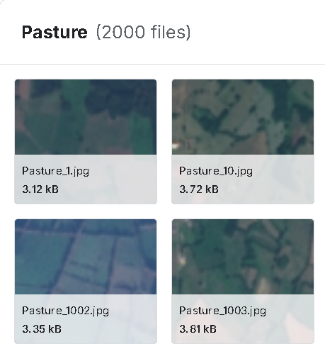
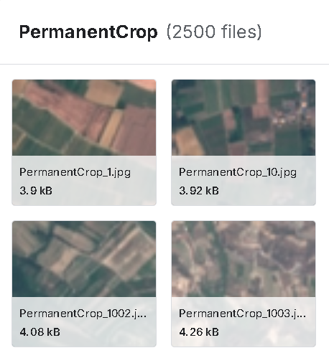
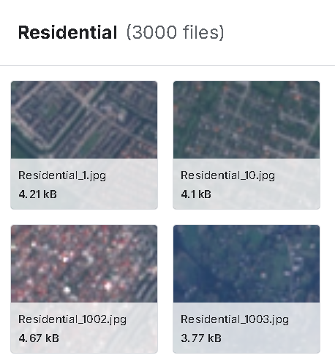
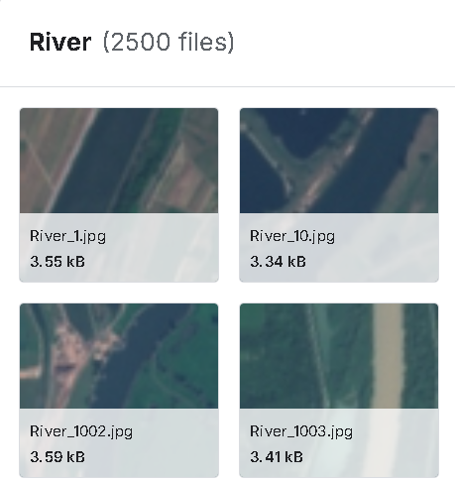
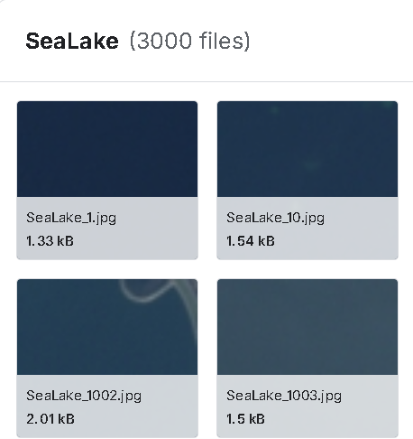
Dataset

Slide 9
Deployment & Live Web App
we focused heavily on deployment – because achieving 99.13% on a benchmark is great, but real impact comes when the model is actually used in the real world.
We built a live web application using Streamlit that is publicly accessible right now. Anyone, anywhere, can upload a new Sentinel-2 RGB image – even one that the model has never seen before – and get an instant classification into one of the 10 land cover classes in less than a second.
The model is lightweight (fine-tuned ResNet-50), runs efficiently on CPU, and we exported it to ONNX and TensorFlow Lite formats.

Slide 10
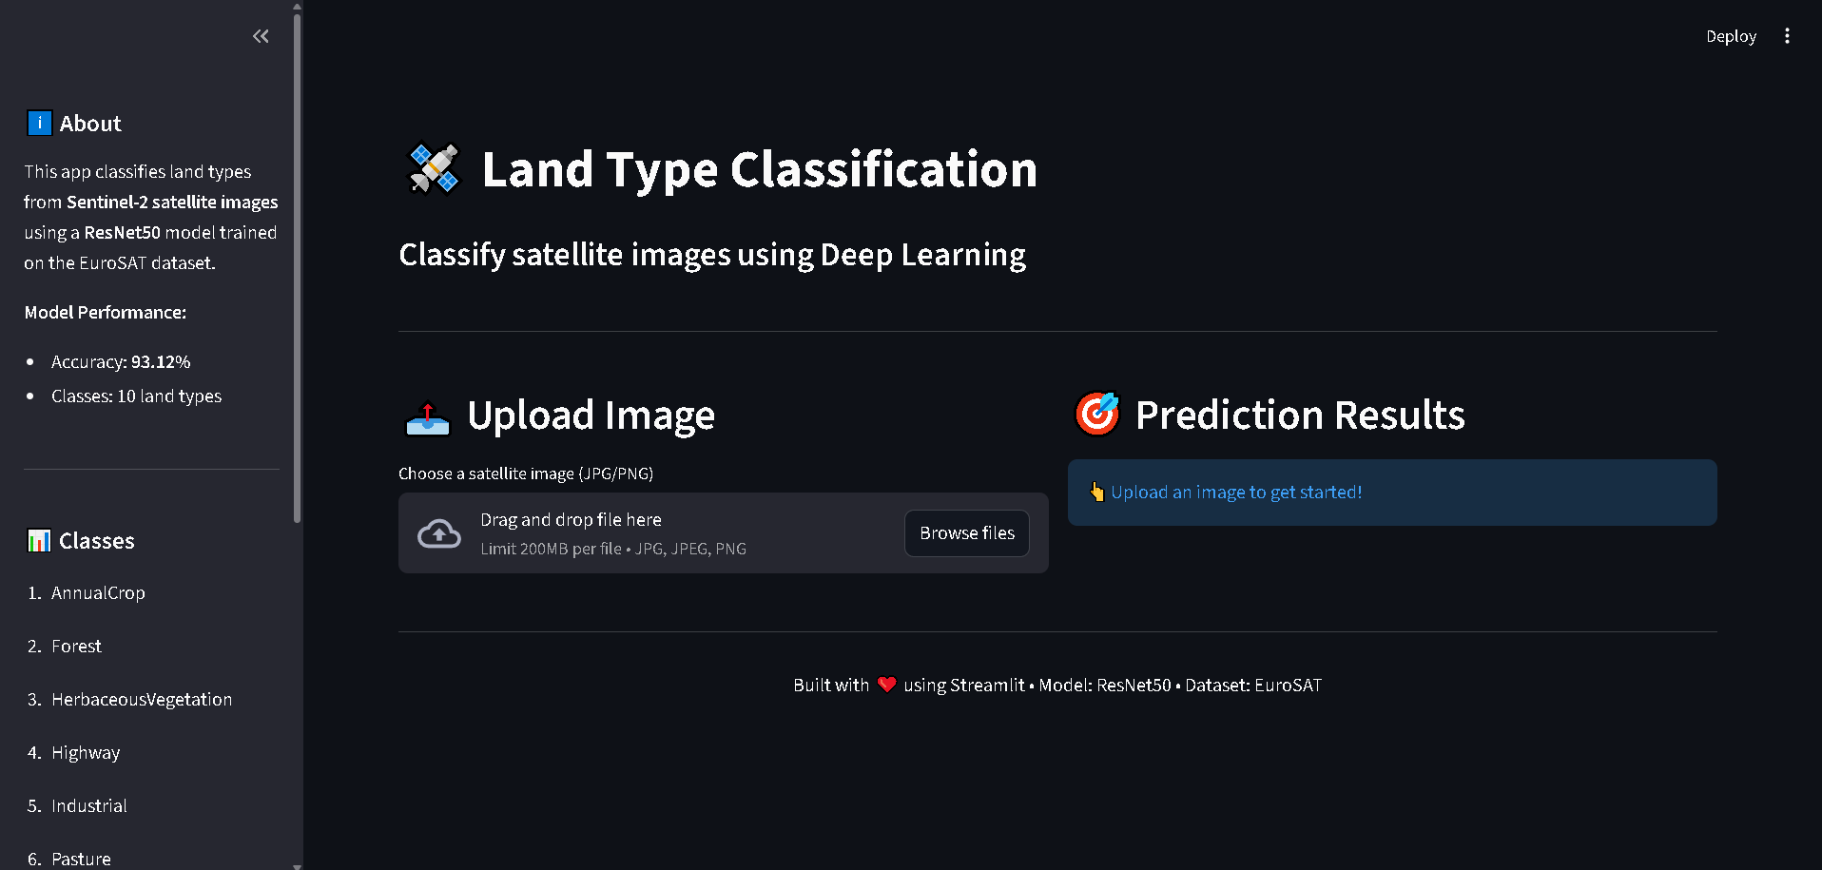
Final Model Performance

Slide 11
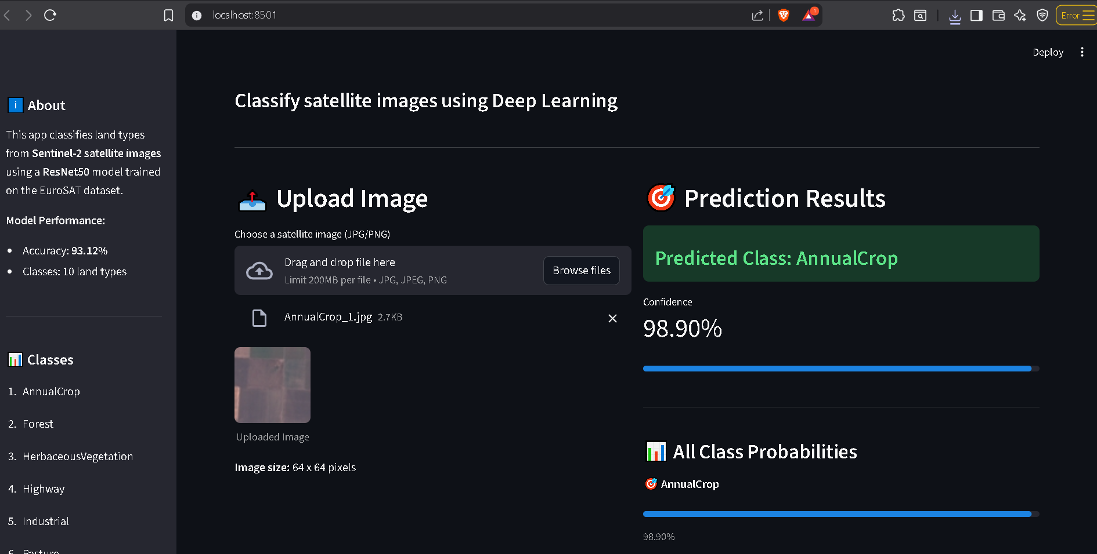
Live Web Application Demo

Slide 12
Programming Language:
• Python – Main language for analysis, modeling, and deployment.
Frameworks & Libraries:
NumPy & Pandas – Data handling and preprocessing of image datasets.
Matplotlib & Seaborn – Visualizing sample images, class distributions, and spectral data.
Scikit-learn & LightGBM – Machine learning models for land cover classification.
TensorFlow / PyTorch – Deep learning frameworks for CNN-based image classification.
Streamlit – Web app framework to deploy the classification model.
Supporting Technologies:
• GitHub & Mlflow – version control and collaboration.
• Streamlit Cloud – Application hosting.

Slide 13
Deliverables
Reports
EDA Report .
Data Analysis Report .
Model Selection Summary.
Training and Evaluation Report.
MLOPS Report.
Final Project Report.
Milestones & Deadlines
Milestone 1 (Data preparation) → [10-10-2025].
Milestone 2 (analysis & features) → [25-10-2025].
Milestone 3 (Model Development & Evaluation) → [10-11-2025].
Milestone 4 ( Model Deployment – Live Web App) → [20-11-2025].
Milestone 5 (Final report & Presentation) → [20-11-2025].

Slide 14
Deliverables
Source Code Repository:
Access the complete code, trained model, and documentation for the Sentinel-2 Land Cover Classification (EuroSAT – 99.13% accuracy) project on GitHub:
Live web demo available at: https://github.com/nhahub/NHA-076

Slide 15
Milestone Breakdown
Milestone 1 – Data Preparation
Milestone 2 –Analysis &Features
Data Collection: Mohamed & Seif .
EDA: Abdallah & Nour .
Preprocessing: Menna & Abdulrahman.
Advanced Analysis: seif & Abdulrahman.
Feature Engineering: Mohamed & Abdallah.
Visualization: Menna & Nour.
Milestone 3 – Model Development
Milestone 4 – Deployment
Model Training: Menna & Mohamed.
Hyperparameter Tuning: Seif & Nour.
MLOPS: Abdallah & Abdulrahman.
Deployment: Mohamed & Seif.

Slide 16
Thank You!
I appreciate your time and attention.
Please feel free to ask any questions or share feedback.

